Slide 1
Shooting Stars:
GGroup 10:
Jasper (Bowen Pang)
Aditya Parmar
Tom Bui
Tejas Sharma
Analyzing NBA Player and Game Statistics

Slide 2
Objectives for Data Analysis
To better understand how the NBA evolves over the years by analyzing two key parts, NBA player demographic trends and overall playstyle change.

Slide 3

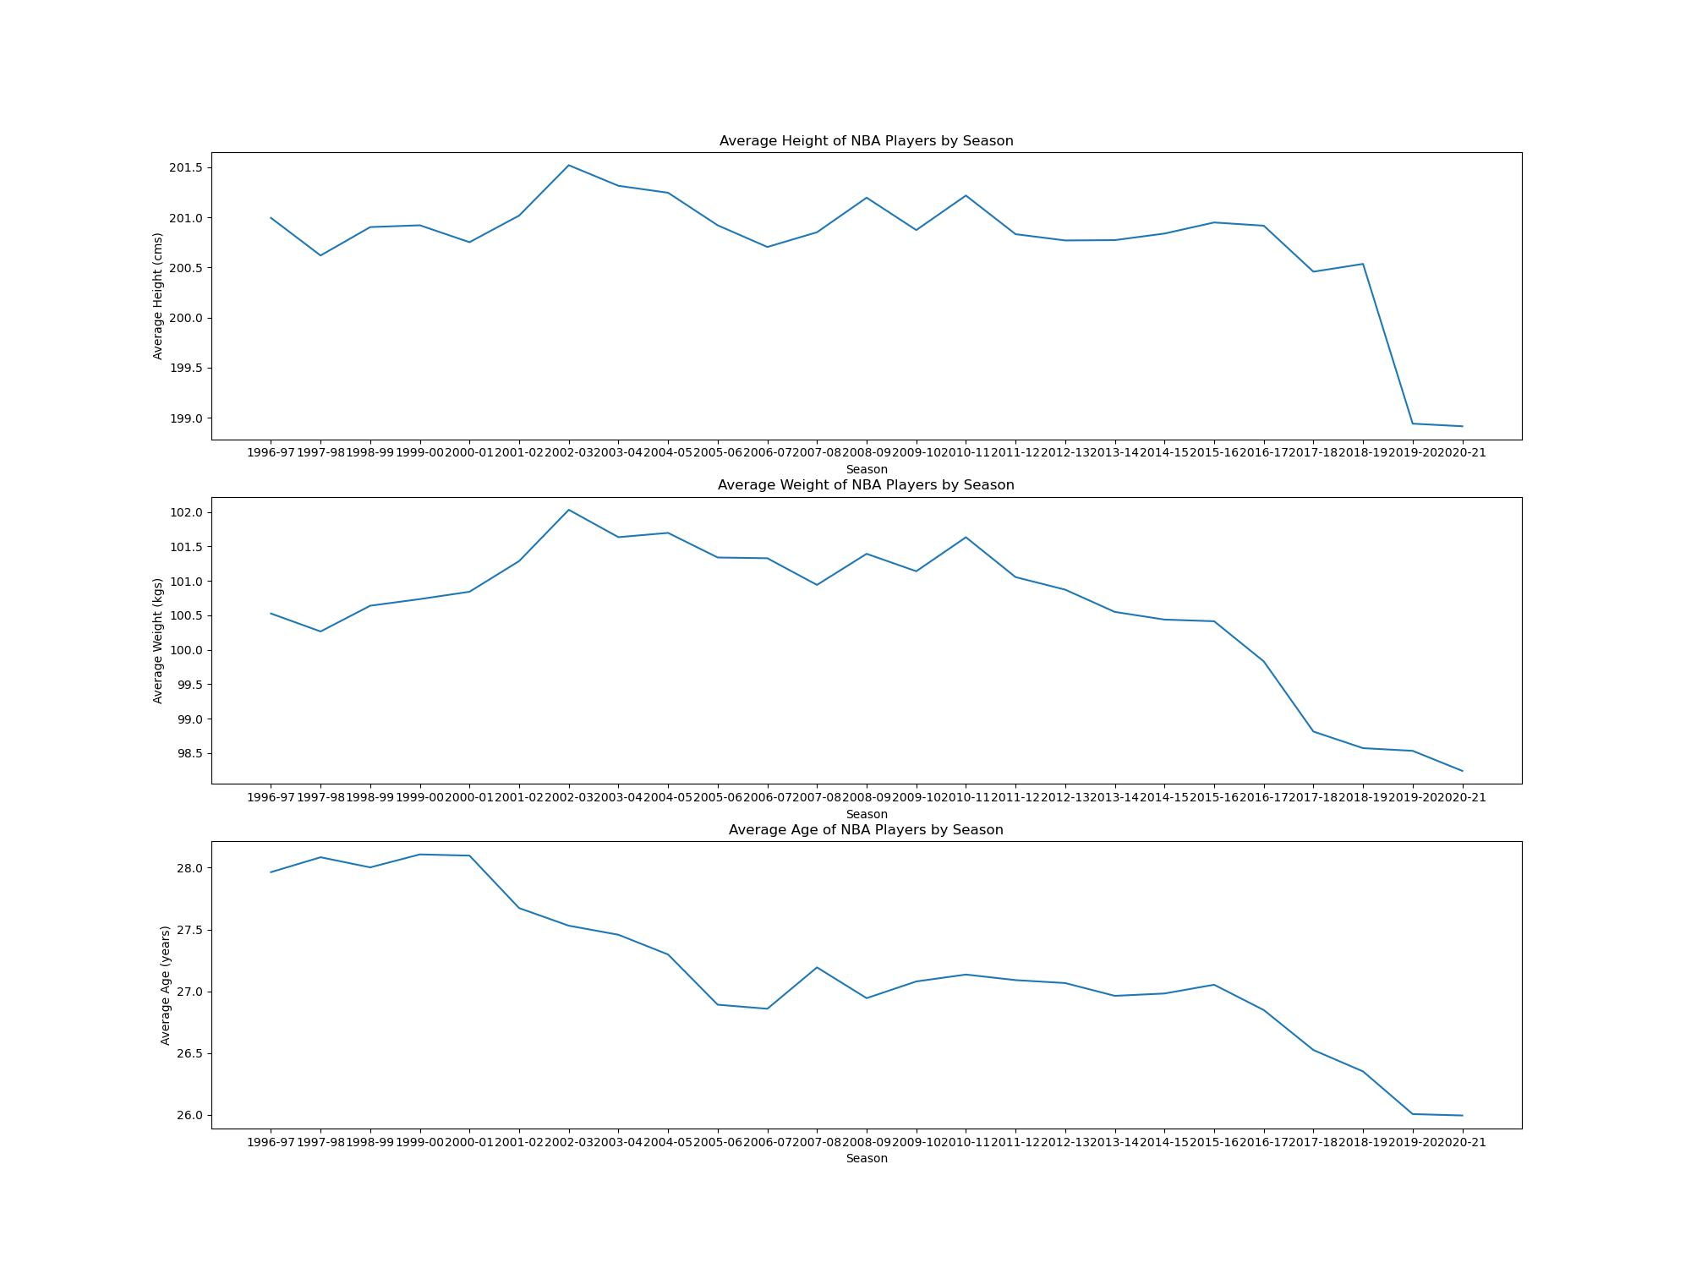
Tejas

Slide 4
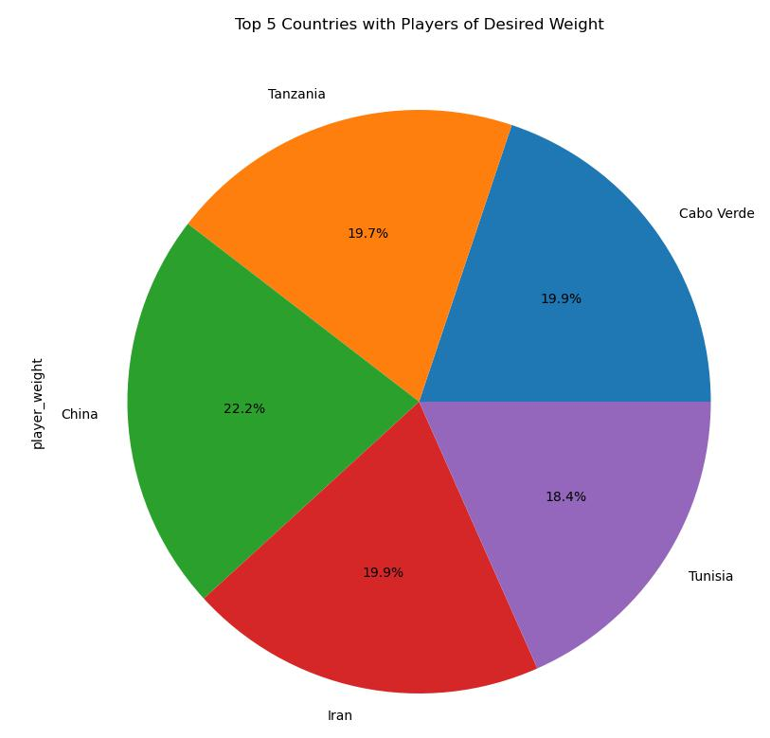
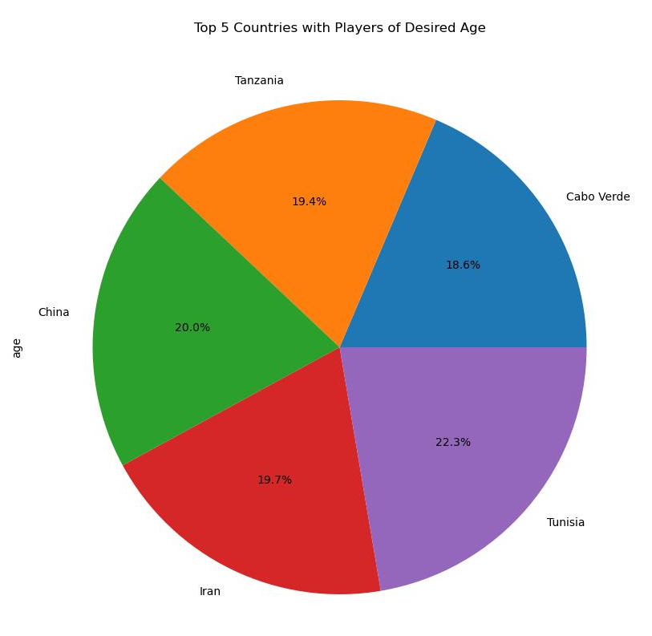
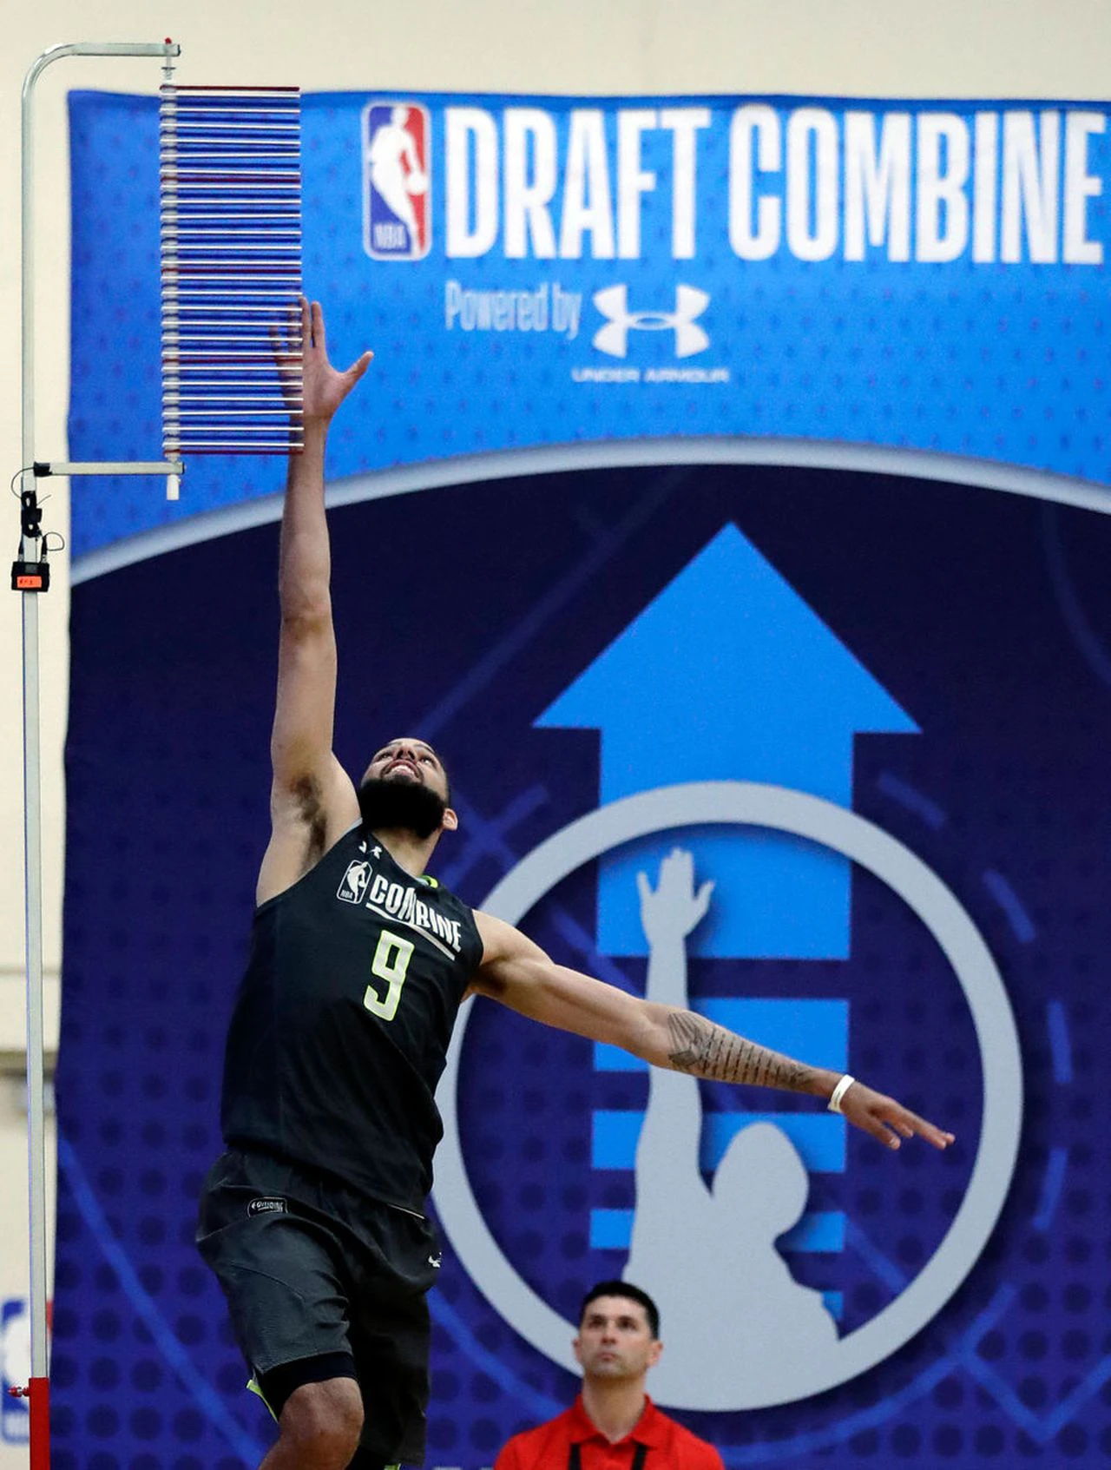

# Desired Height Avg > 200cms
# Desired Weight Avg < 98 kgs
# Desired Age Avg Between 25~30 years

Slide 5
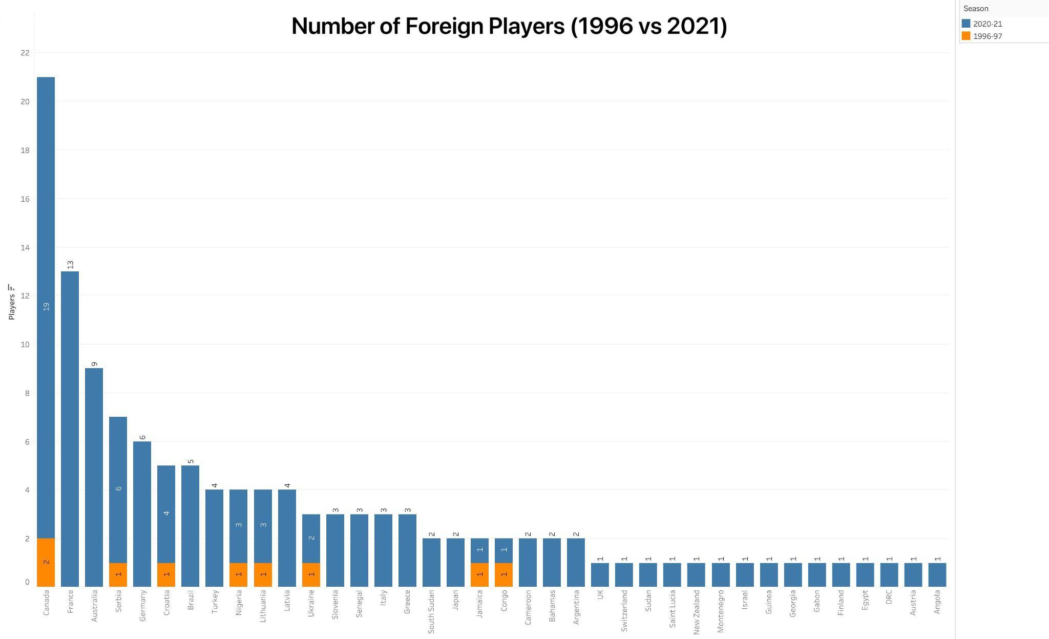

Slide 6

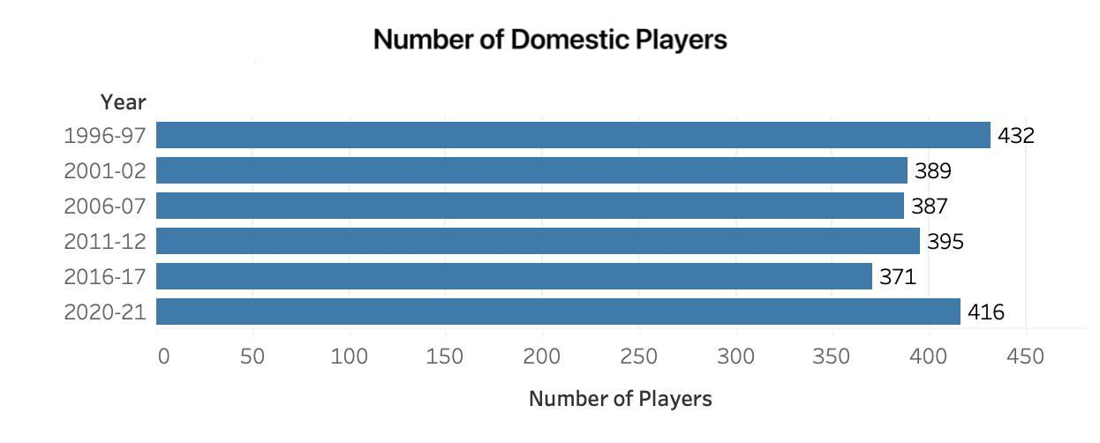

Slide 7
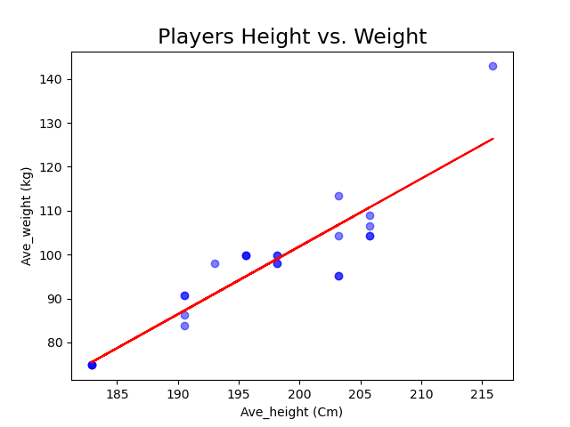
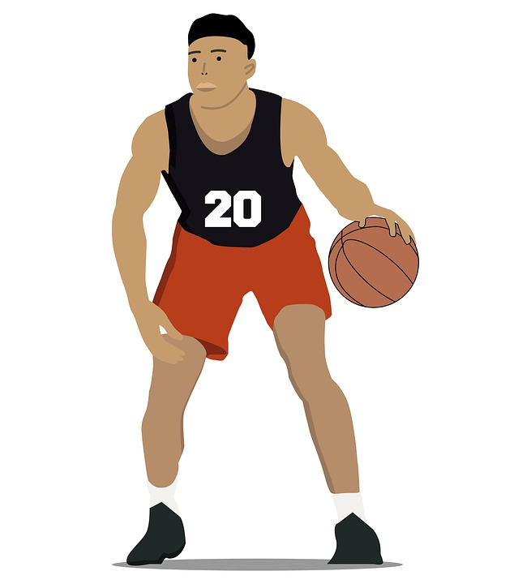
Correlation between Player’s Height and Weight
Correlation in between top player’s height and weight is 0.93 !!
Strong positive relationship between two variables.

Slide 8
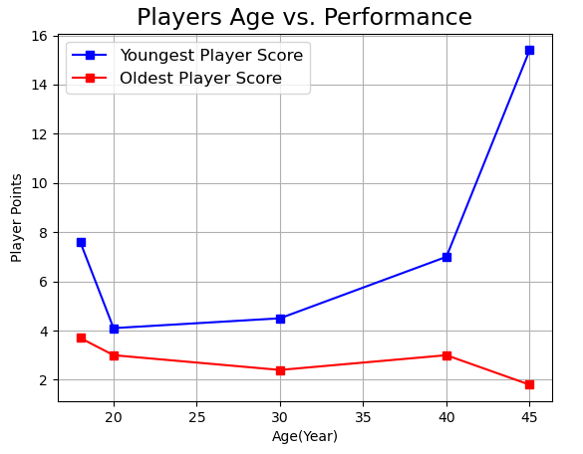
Comparison of Youngest vs. Oldest Players
Younger players may have better physical attributes can give them an advantage.
Older players may experience declines in physical performance, which can impact their ability to score the goals.
Other factors like skill level, position and team strategy.

Slide 9
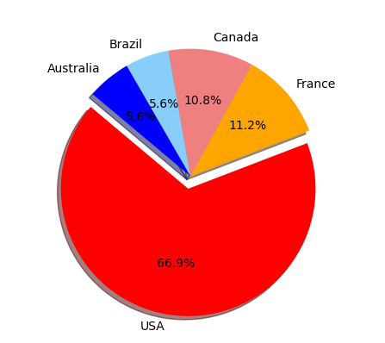
Contribution of different countries
United States is major contributor to the NBA is not surprising.
France, Canada, Brazil and Australia producing more NBA talent in recent years.
NBA is truly a global sport, with the players from all around the world.
THANK YOU

Slide 10
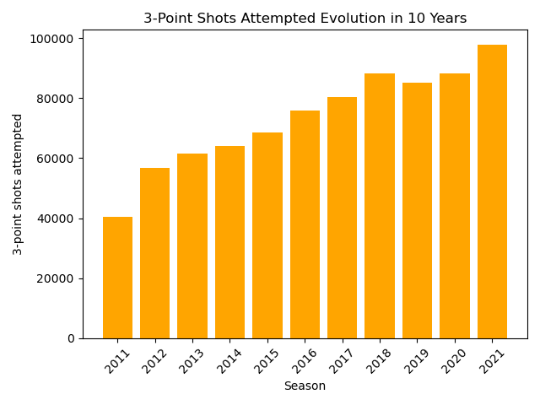
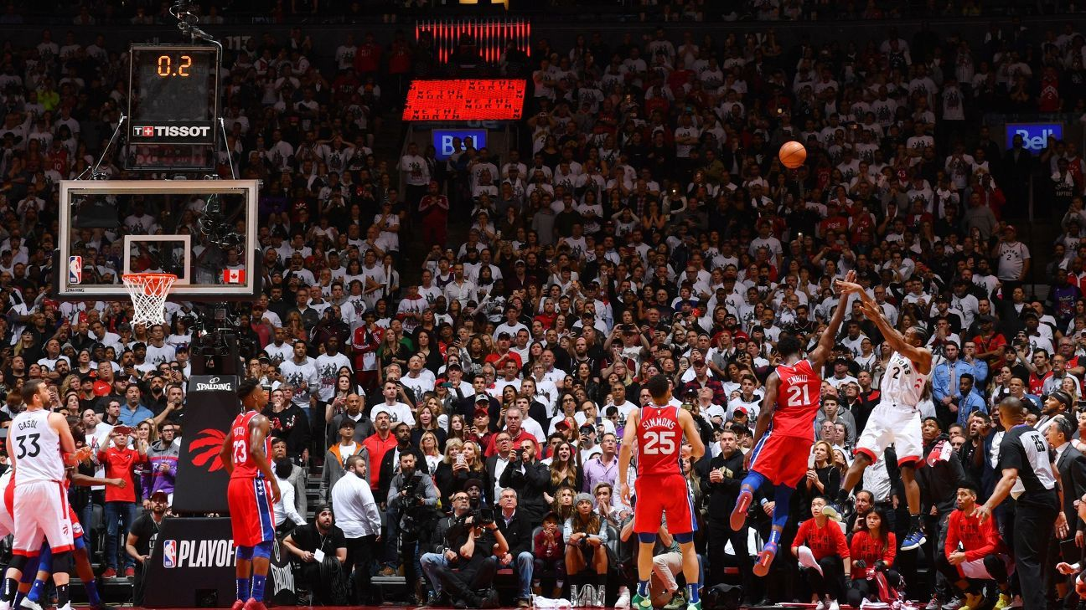
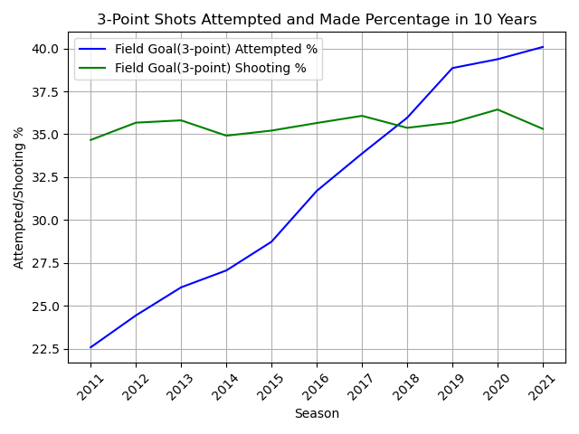
The Dramatic Change in Playstyle:
Raining threes in NBA
Field Goal: is a basket scored on any shot or tap, worth two or three points depending on the distance of the attempt from the basket.
Data Period: 2011-2021
3-Point Shooting % = (3-Point Made/3-Point Attempted)*100%
3-Point Attempted % = (3-Point Attempted/Field Goal Attempted)*100%

Slide 11
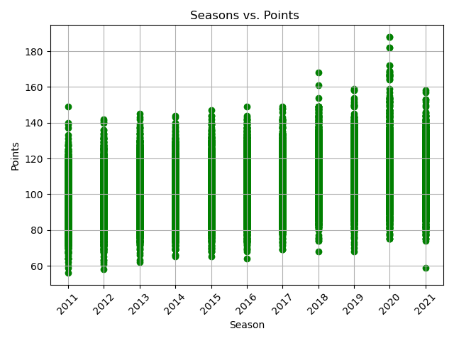

Correlation between Seasons and Points
(each dot stands for the points scored by one team per game )
Is it obvious that there is a strong correlation or nah?

Slide 12
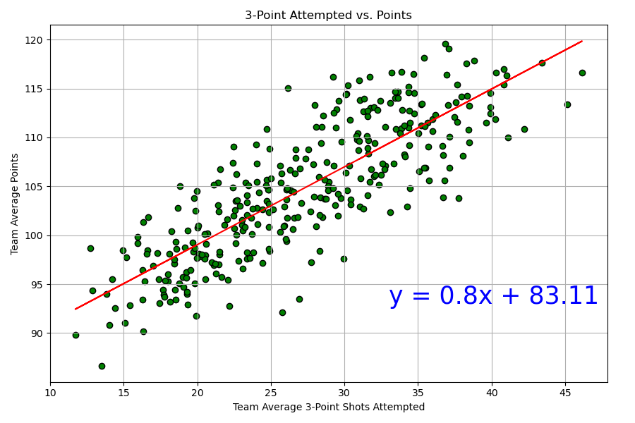
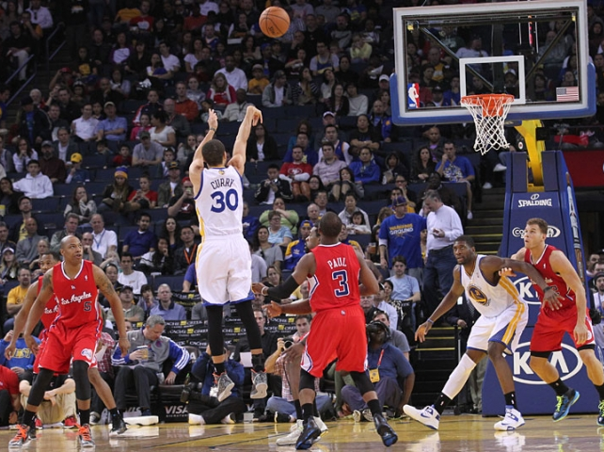
Correlation between 3-Point Shots and Team Avg Points
with Fitted Linear Regression Line
Strong positive relationship between two variables w/ correlation coefficient of 0.8
The R² is equal to 0.7

Slide 13

THANK YOU!

